Slide 1
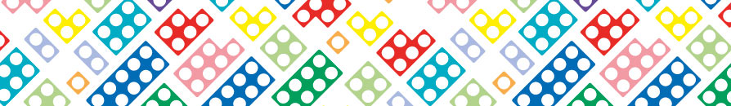
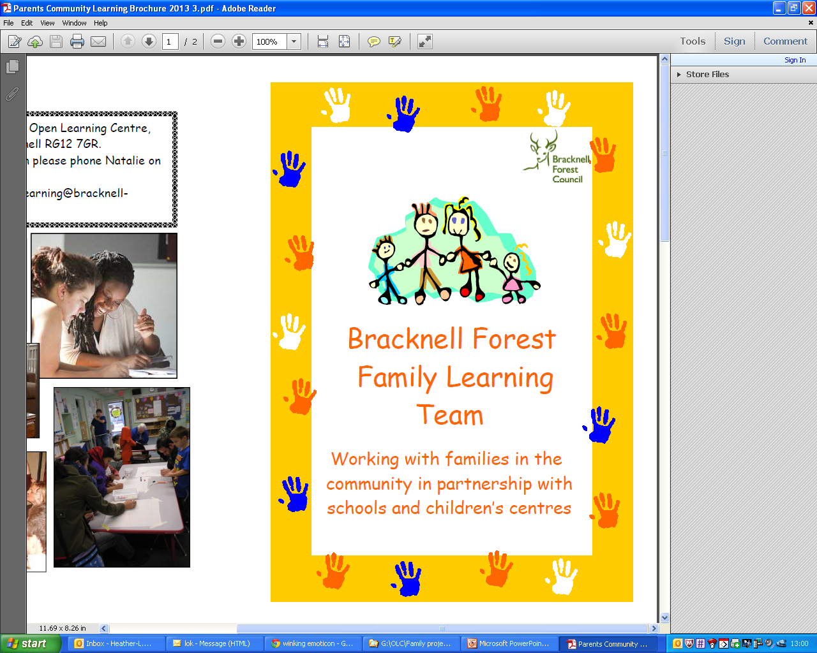

Slide 2
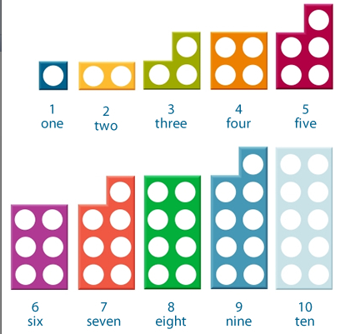
Using Numicon

Slide 3

Numicon is a maths resource that uses a series of structured images to represent numbers.

Slide 4
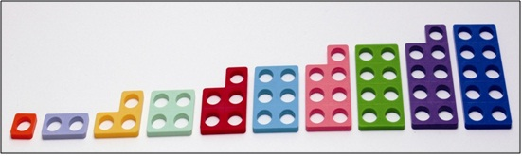
It can be quite difficult to explain to a child the mathematical concept of ‘five’.
But the Numicon shape for ‘five’ looks like ‘one less’ than six and ‘one more’ than four.

Slide 5
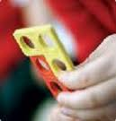
Numicon shapes are designed to exploit three key strengths of young children, in order to help them understand number:
Learning from doing
Learning from seeing
Children’s strong sense of pattern.

Slide 6
Why Use Numicon?
Children can understand number relationships
Children can do calculating without counting
Children learn mathematical language
Children learn to make connections and to use and apply their understanding.

Slide 7
How do we use Numicon?
- Making numbers real https://www.youtube.com/watch?v=W23e_7DhGOw
…………………………and further watching at home if you wish…………
Numicon at home video https://www.youtube.com/watch?v=Rw_LgDKwdgI
-The Primary 1,2 guide to Numicon in 7 minutes https://www.youtube.com/watch?v=EIGN3ekzpjc

Slide 8
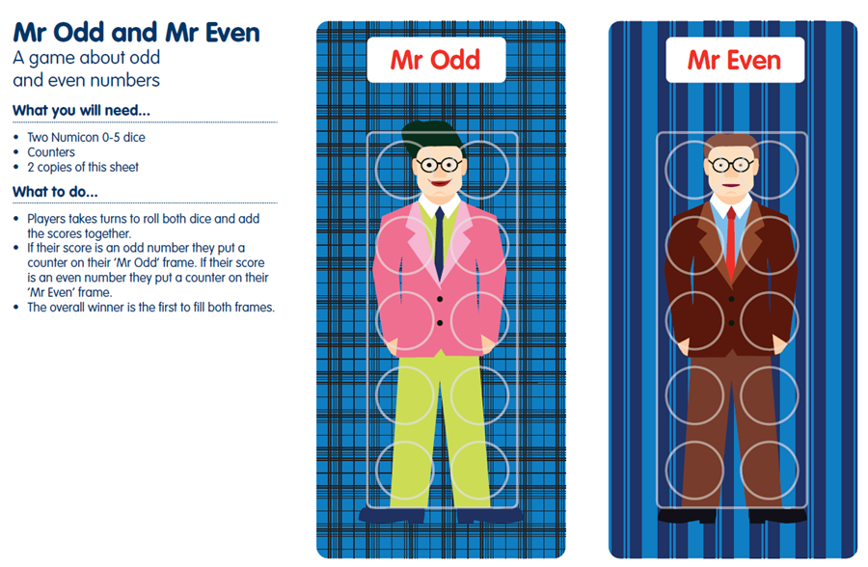
Games you can play…….
Odd & even:

Slide 9
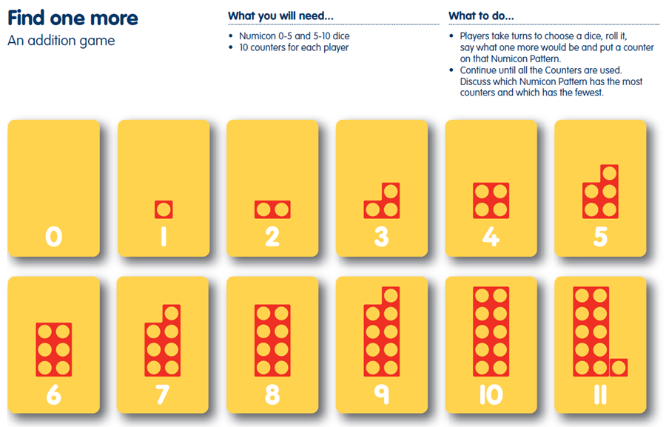
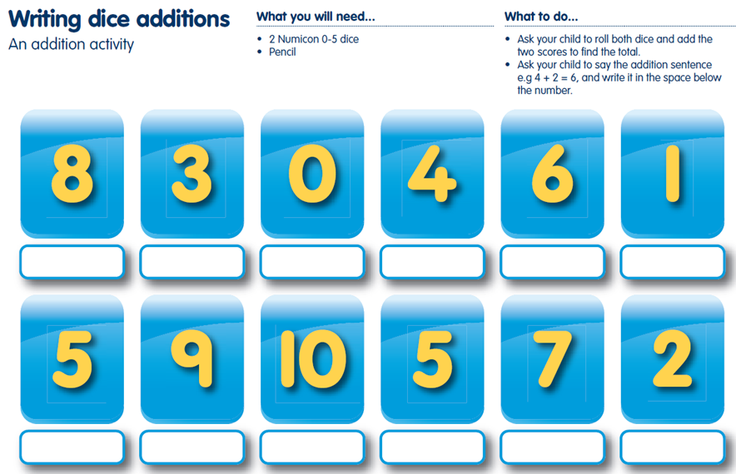
Addition:

Slide 10
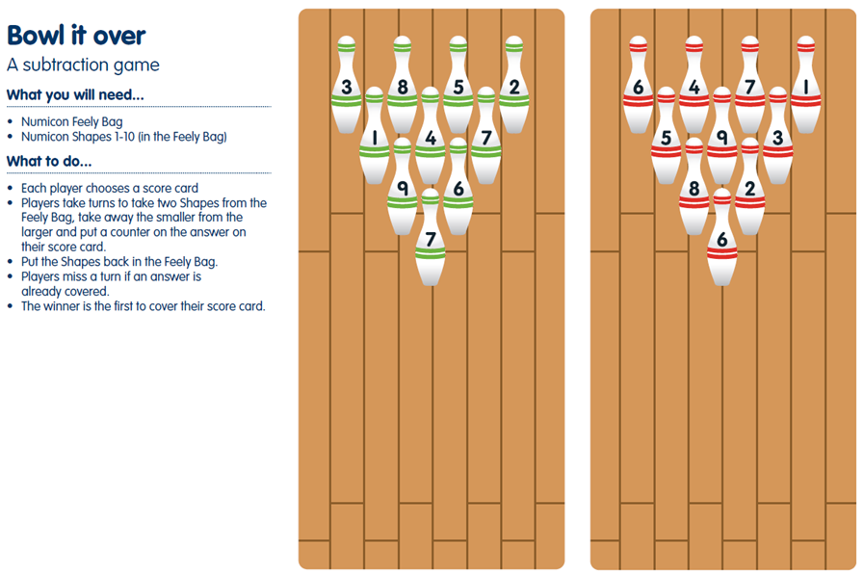
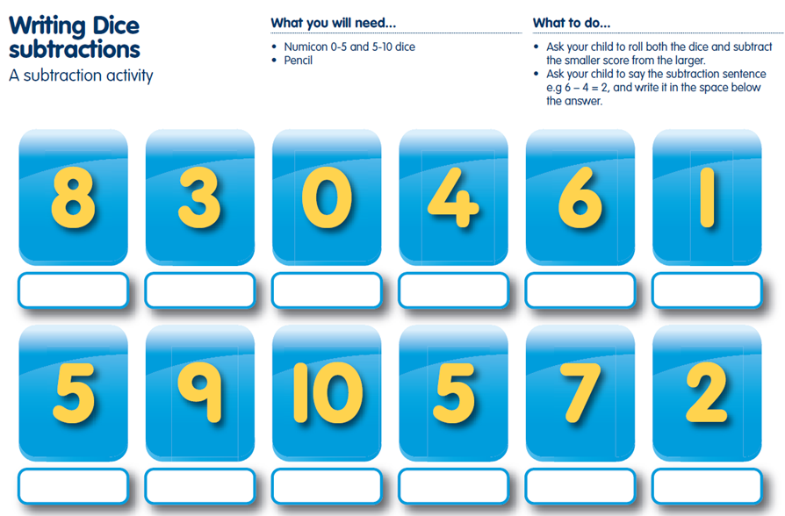
Subtraction:

Slide 11
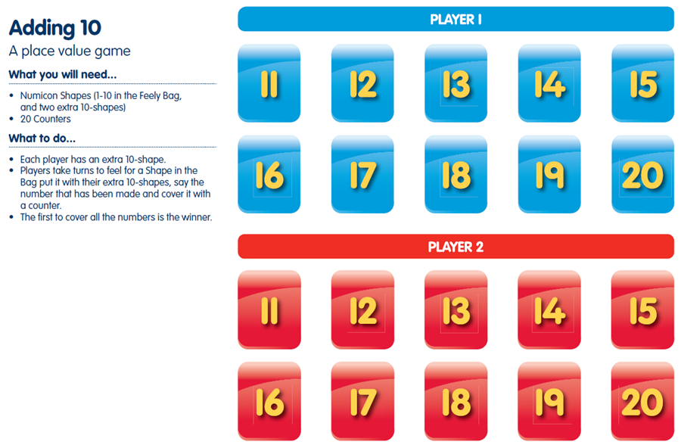
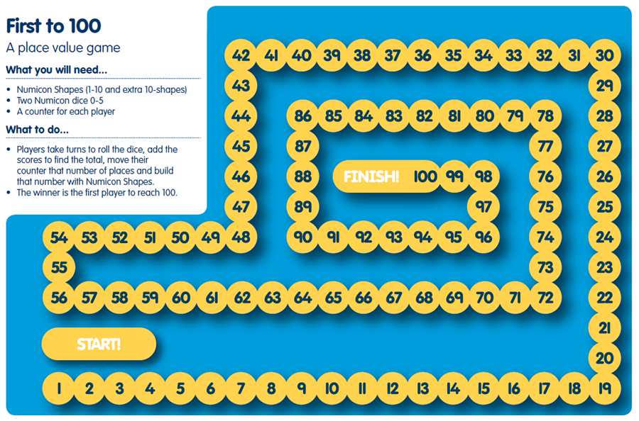
Place Value:

Slide 12
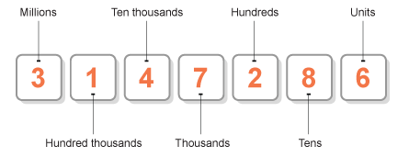
What is place value?
The value of where the digit is in the number, such as units, tens, hundreds, etc.
For example, in 352, the place value of the digit 5 in that number is "tens"
Look at the seven digit number below:
What is the value of the digit 2 in the number 3 147 286 ?
http://www.softschools.com/math/place_value/teaching_place_value/
Notes:
12

Slide 13
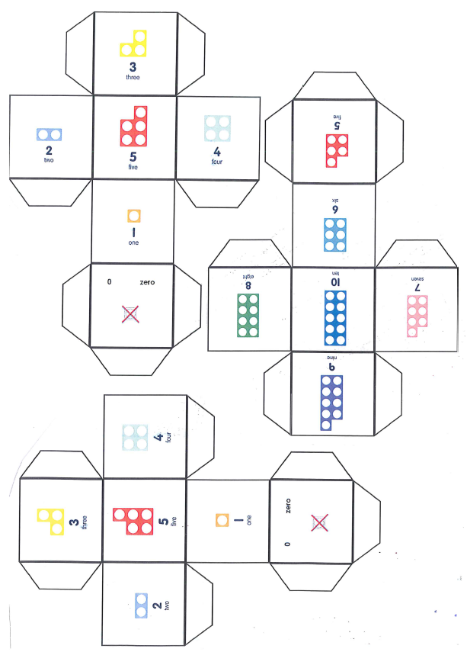
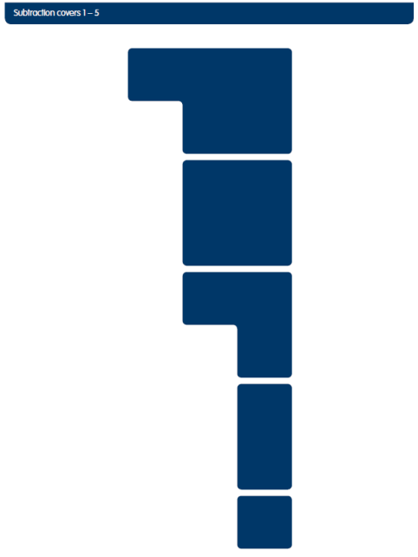
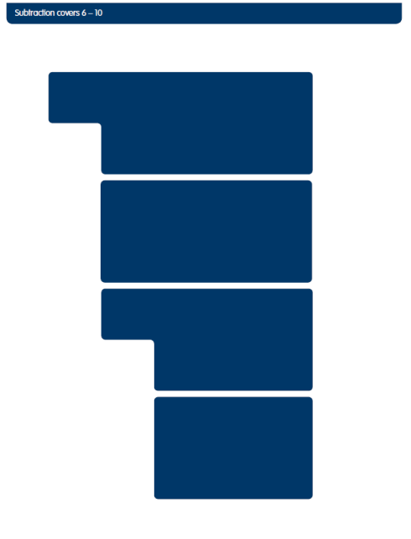
Extras to make & take home…….
Numicon dice:
Subtraction covers:

Slide 14
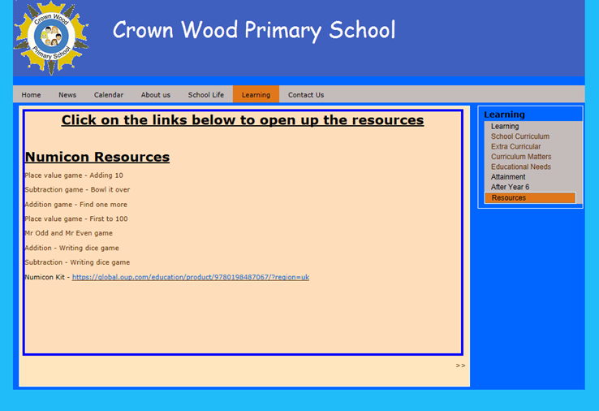
The children will now join us and you can choose a couple of games/activities that you think your child will enjoy.
Have fun……
Copies of these games, and others, will be available on the school website – go to http://www.crownwoodschool.com/menu/mnu5.shtml
Click on the ‘resources’ tab
*More resources will be
added next term
(website due for update
in July)

