Slide 1
Crown Wood Primary School
RWI Set 1
Sound of the day
s

Slide 2


Our sound of the day is

Slide 8
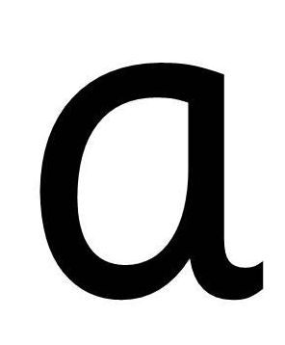

Slide 10

Hello Fred!

Slide 11


Slide 12
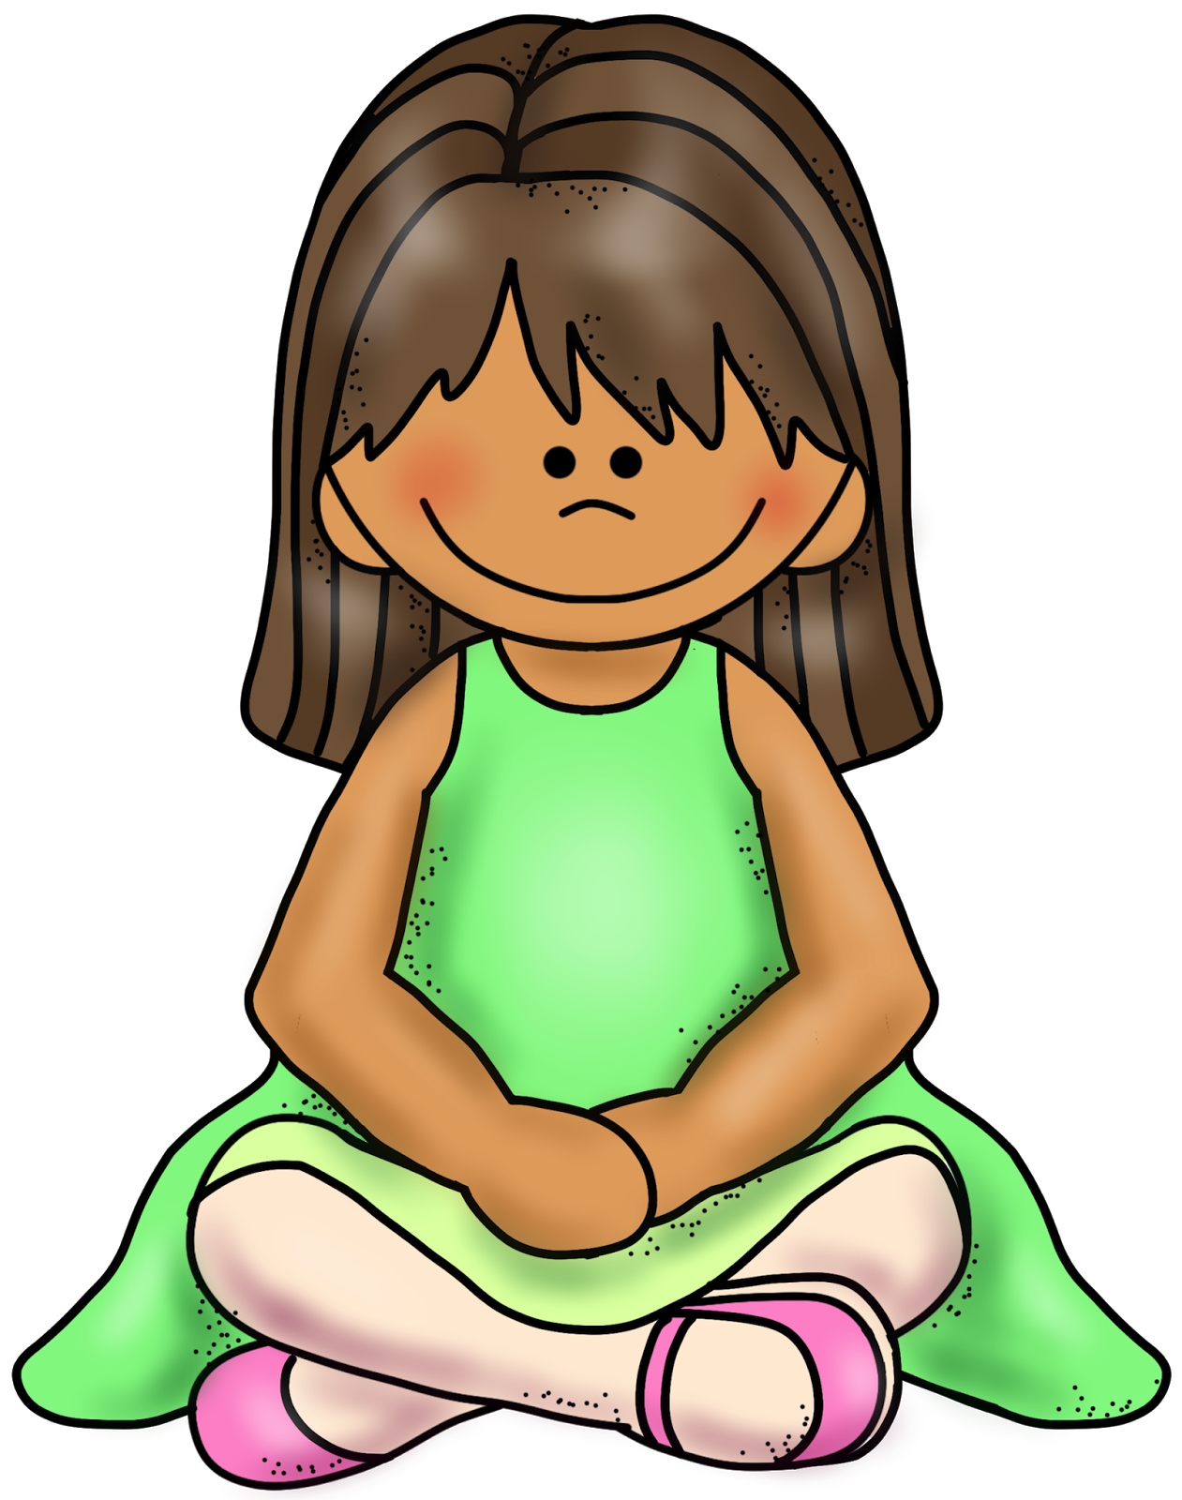

Slide 14


Slide 16


Slide 18


Slide 19


Slide 21
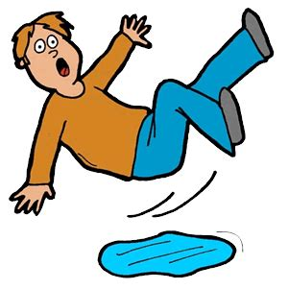

Slide 22


Slide 23
Slither down the snake

