Slide 1
Crown Wood Primary School
RWI Set 1
Sound of the day
d

Slide 2

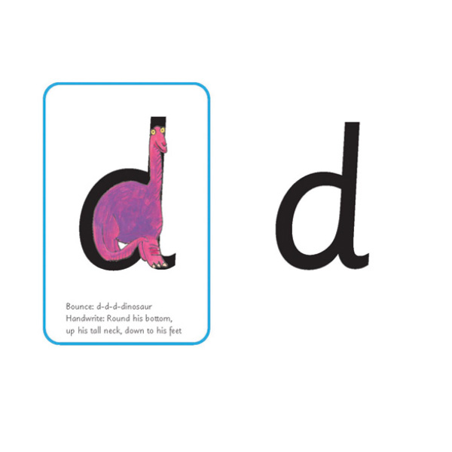
Our sound of the day is

Slide 7


Slide 10

Hello Fred!

Slide 11


Slide 12
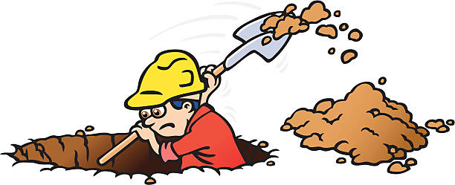

Slide 14


Slide 16


Slide 18


Slide 19


Slide 21
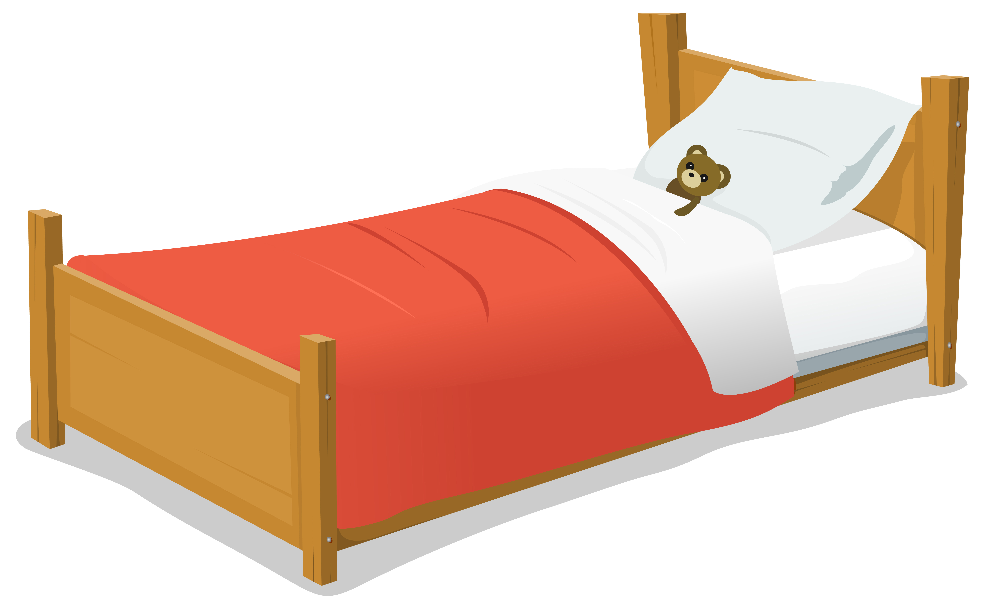

Slide 22


Slide 23
Round his bottom, up his tall neck, down to his feet

