Slide 1
Handwriting Guidelines
Crown Wood Primary School
November 2019

Slide 2
Headlines
Initial Stages (EYFS – KS1):
  Basic letter shapes
  Size of letters / Orientation
  Ways the letters join together
Developing handwriting & Fluency (KS2)
Avoid mini-whiteboards / Stick in practice sheets
Casual Cursive (not every letter has to be joined)
Teach the handwriting position*
Expectations!

Slide 3
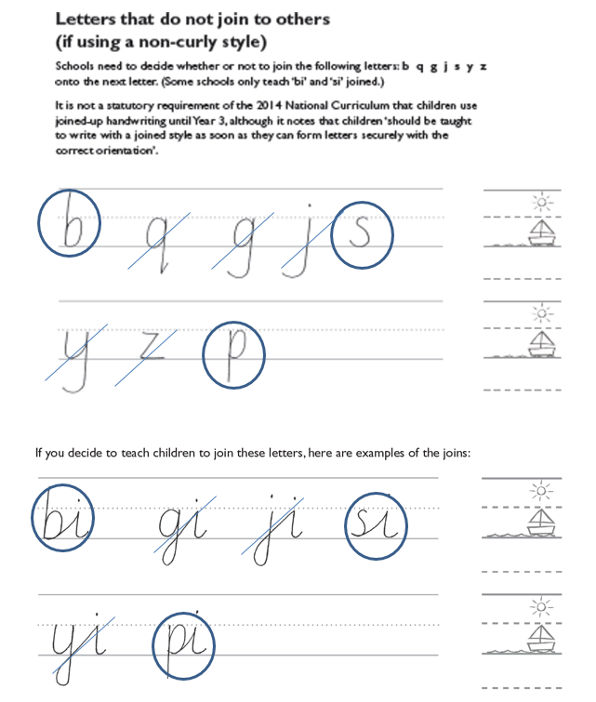
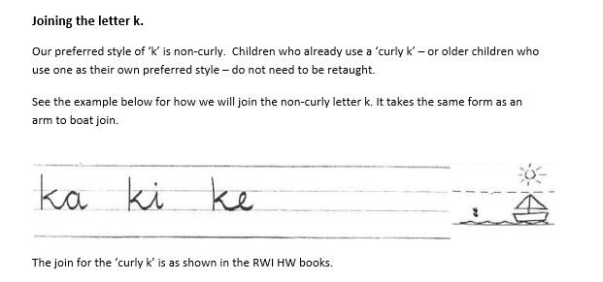

Slide 4
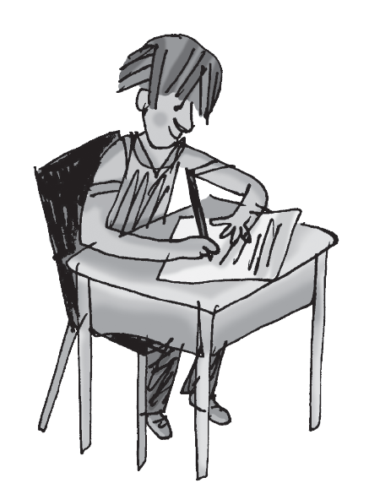
Handwriting position*
Teach children that when you use the handwriting signal they automatically go into the perfect handwriting position:
feet flat on the floor
bottom at the back of the chair
body one fist from the table
shoulders down and relaxed
back leaning forward slightly
left/right hand holding the page
left/right hand ready in a tripod grip

Slide 5
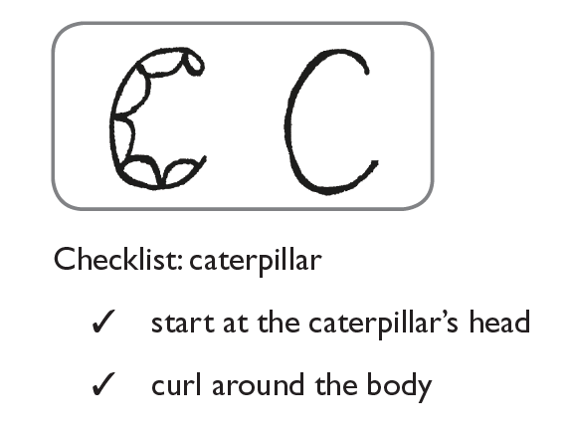
Letter Formation
Starting in Year R
RWI HW Stage 1a
Linked to phonics

Slide 6
Size / Orientation
In Year R SUM2, move to Stage 1b (controlling the size of the letters)
Year 1 focus
RWI Stage 1b into Stage 2
Sitting correctly; comfortable grip
Lower case and capital letters
Digits 0-9
Handwriting families

Slide 7
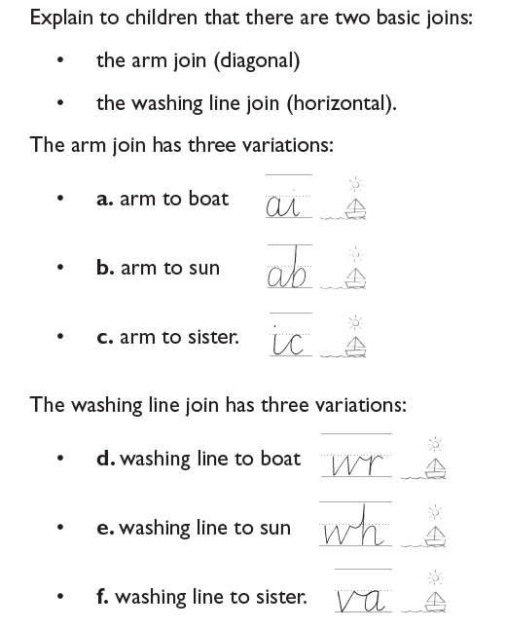
Ways the letters join together
Start teaching ‘arm to boat’ joins from SPR Year 1
Other joins in Year 2
RWI HW Stage 3

Slide 8
Developing joined handwriting
Year 3
  Continue to use RWI HW Stage 3
  Expectation children are beginning to join their writing during Year 3
  Practise / revise letter formation, relative size etc as required
  Daily practice, reducing to three per week in SPR1 – use handwriting books if required
Year 4
  Expectation writing is joined and there is increasing legibility and consistency in all independent writing
  Practise / revise letter formation, relative size etc as required (using RWI HW Stage 3)
  Daily practice, reducing to three per week in SPR1 – use normal lined books

Slide 9
Fluency and Speed
Year 5
  Continue to practice 3 times per week
  Intervene if needed!
  Fluency and speed
  All children to have a ‘pen licence’ by Christmas*
Year 6
  Intervene if needed!
  Fluency and speed
  All children to start Year 6 with a pen

Slide 10
Pen Licence*
Children should move on to use a pen for writing when they regularly and consistently demonstrate the following:
Write legibly, fluently and with increasing speed
Choose which shape of a letter to use when given choices and deciding whether or not to join specific letters
Choose the writing implement that is best suited for a task (e.g. a pencil for drawing diagrams or for mathematics calculations etc)
Use a tripod grip
Sit in the ‘handwriting position’ to write
Our aim is every child has a pen licence by the end of the Autumn Term in Year 5. However, children can gain a pen licence before Year 5 and some children will take longer to gain one.

