Slide 1
Crown Wood Primary School
RWI Set 1
Sound of the day
i

Slide 2

Our sound of the day is
i

Slide 3
i

Slide 4


Slide 5
i

Slide 7
i

Slide 9
i

Slide 10

Hello Fred!

Slide 11


Slide 12


Slide 14
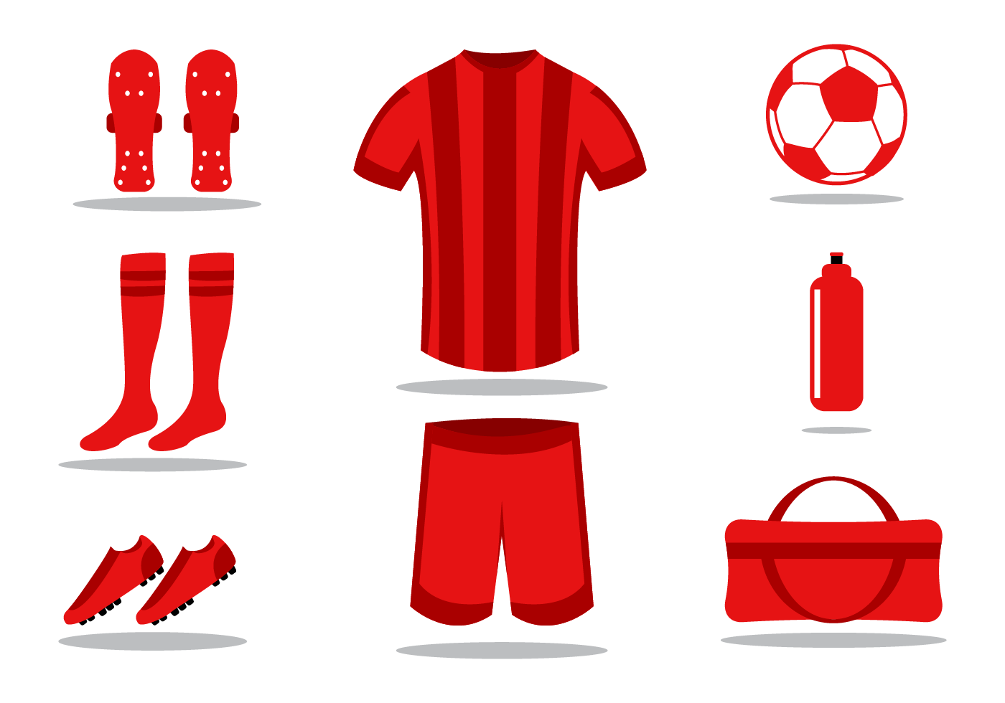

Slide 16


Slide 18
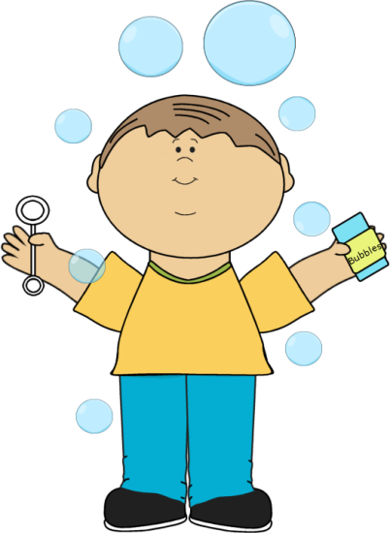

Slide 19


Slide 21


Slide 22


Slide 23
Down the body, dot for the head
i

